Slide 1

Energy
Heat and Solar Energy
Mandek Richardson
University of South Florida
STARS Program

Slide 2

Vocabulary
Heat
System
Conduction
Convection
Radiation
Reflection
Solar Energy
Light

Slide 3







Forms of Energy
Light/Solar
Chemical cal
Sound
Electrical
Mechanical
Heat
Thermal
Nuclear
Nuclear

Slide 4
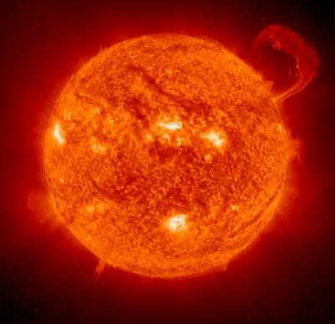
Solar Energy
Solar energy is energy that comes from the sun

Slide 5
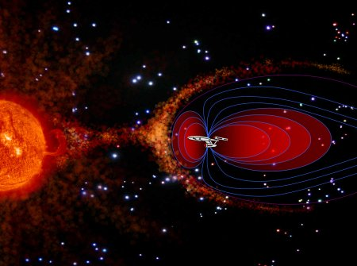
Energy from the sun travels as radiation
The sun produces several types of radiation
Light we see
Heat we feel
X-rays
Radio waves

Slide 6


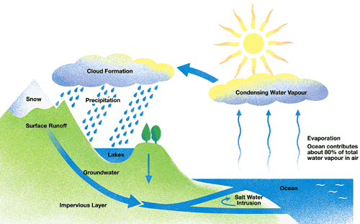
Where is Solar Energy Used?

Slide 7
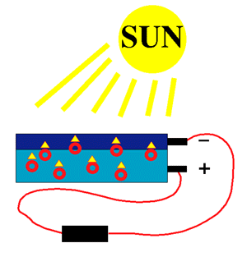
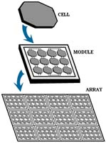
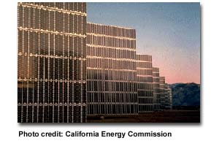
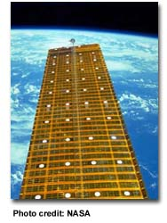
Sunlight and Electricity
Photovoltaic Cells or Solar Cells
Red circles are electrons
or

Slide 8
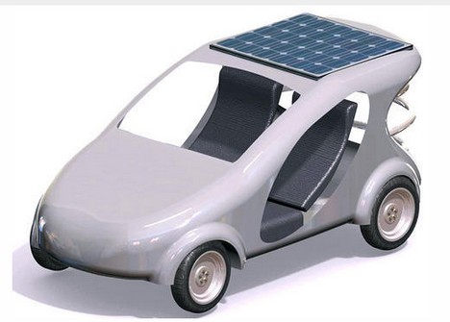
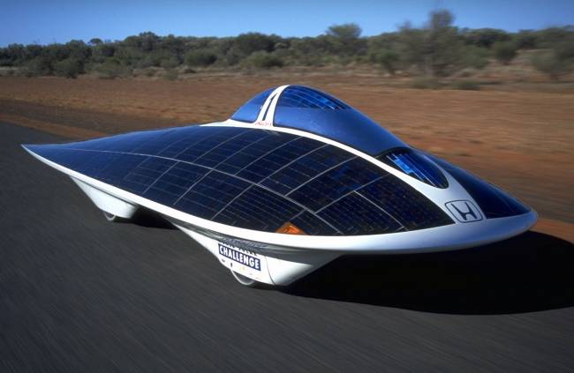
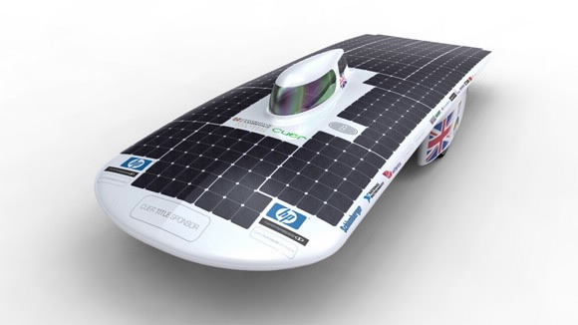
Solar Car
Solar cars have solar panels on their roofs to collect light so that is converted to electricity to run an electric motor

Slide 9
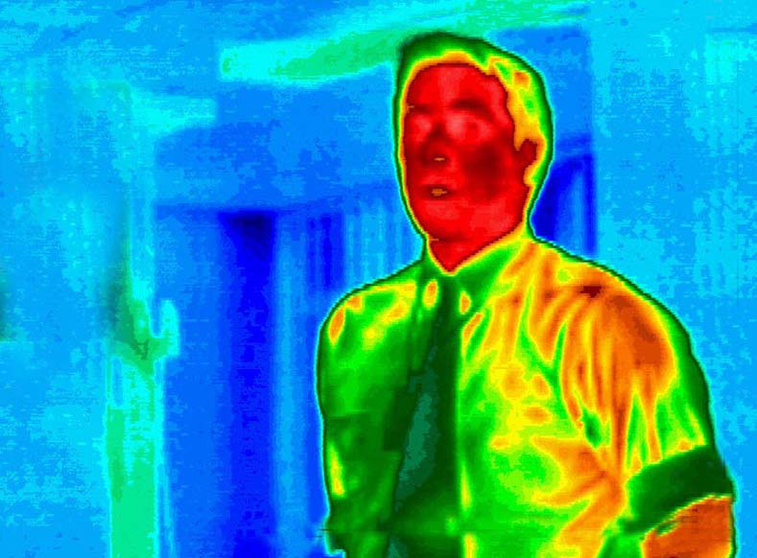
How are heat and temperature
related?

Slide 10
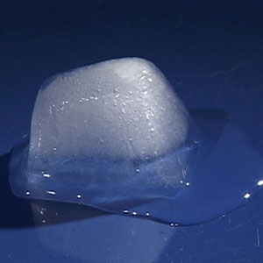
Heat and Temperature
Heat is a type of energy
All things are made of atoms and atoms are always moving
Heat is the total kinetic energy of all the atoms in an object
Even cold things like an ice cube have heat energy just not a lot

Slide 11


Heat and Temperature
Objects with slower moving atoms have Low heat energy.
Objects with faster moving atoms have High heat energy.

Slide 12

Temperature
Temperature is a measurement of the average kinetic energy of the atoms in an object
Temperature is not energy but a measure of it

Slide 13
Heat Transfer
There are 3 ways in which heat can move through a system
  Conduction
  Convection
  Radiation

Slide 14
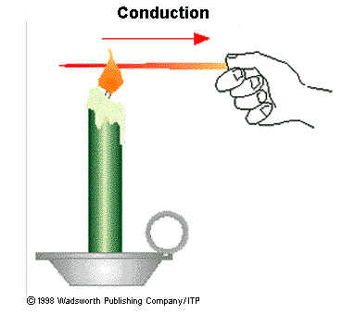
Conduction
Conduction occurs in solids only!
Conduction is the transfer of heat energy from atom to atom by contact only

Slide 15
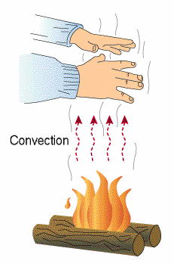
Convection
Convection occurs in liquids and gases
Convection is the transfer of heat energy by the movement of atoms themselves

Slide 16
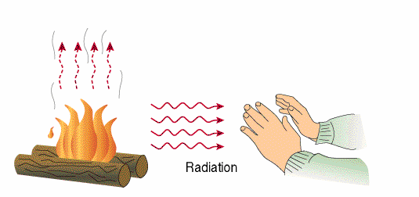
Radiation
Radiation is heat transfer with NO ATOMS!
Radiation is the transfer of heat energy through waves

Slide 17
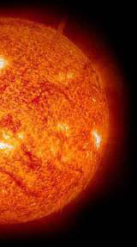

Radiation
Heat radiation can travel through space
It is what keeps the earth warm

Slide 18
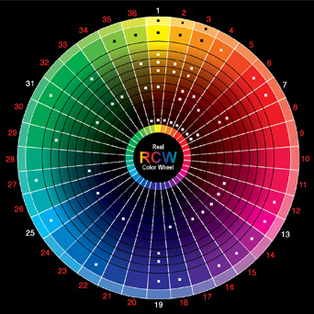
What color absorbs more heat?

